Slide 1
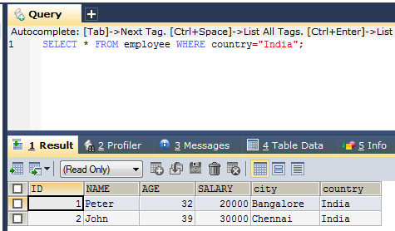
SQL WHERE Clause
The WHERE clause is used to filter records.
The WHERE clause is used to extract only those records that fulfill a specified condition.
SELECT * FROM employee WHERE country="India";
SELECT column1, column2, ... FROM table_name WHERE condition;

Slide 2
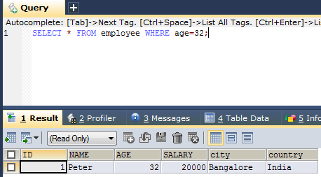
SQL WHERE Clause
SQL requires single quotes around text values (most database systems will also allow double quotes).
However, numeric fields should not be enclosed in quotes:
SELECT * FROM employee WHERE age=32;

Slide 3
SQL WHERE Clause
Operator | Description
= | Equal
> | Greater than
< | Less than
>= | Greater than or equal
<= | Less than or equal
<> | Not equal. Note: In some versions of SQL this operator may be written as !=
BETWEEN | Between a certain range
LIKE | Search for a pattern
IN | To specify multiple possible values for a column
https://www.w3schools.com/sql/sql_where.asp

